Slide 1

한인 이민사 초급
Notes:
한인 이민사
Korean immigration history

Slide 2
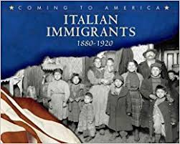
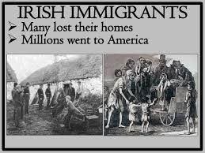
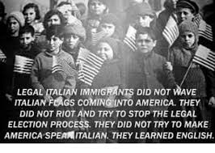
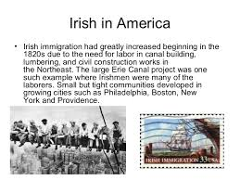
다른 민족의 이민 역사
이탈리아인의 미국 이민
아일랜드인의 미국 이민
Notes:
Have you ever heard about the history of Korean immigration to other countries? Before looking at Korean immigration, let's take a look at the immigration of other ethnicities. The United States is a country where immigrants from various countries live together. They are pictures of Italians and Irish immigrants in the United States.

Slide 3
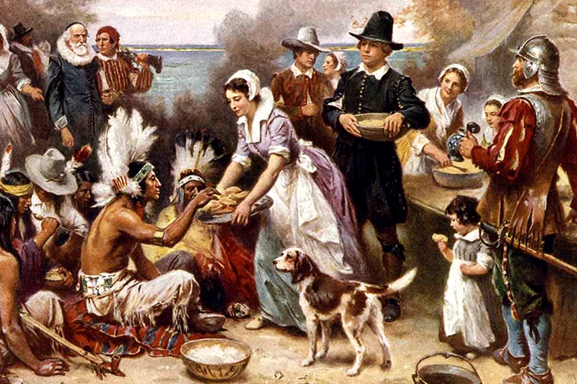
청교도의 첫 추수감사기념제(1621년)
Notes:
This is a picture of Pilgrims, who immigrated from England to North America, celebrating their first Thanksgiving. What do you see?

Slide 4
한인 이민 전 시대적 배경
정부의 무능함 / 지역 탐관오리의 횡포
청(중국)의 간섭
강화도 조약 (일본) : 불리한 외교 관계
서구 나라들과의 불평등 조약의 시작
동학운동 초래
Notes:
In order to know about Korean immigration that began in the 19th century, it is necessary to find out the situation of 조선 at that time. Let’s look at the 동학 peasant Movement and the 강화 Treaty.

Slide 5
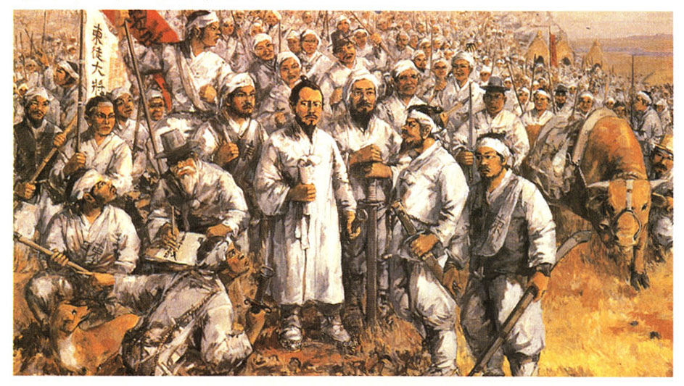
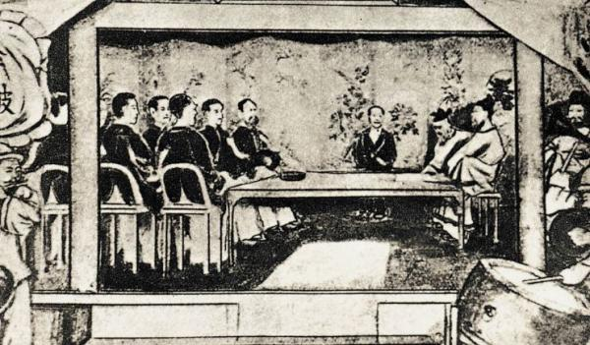
동학 운동과 강화도 조약
동학농민운동
강화도 조약
동학운동
강화도 조약
국내적으로 탐관오리의 횡포
국외적으로 청나라(중국)의 침략
조선은 자주국이며 일본과 평등한 권리를 가진다.
조선은 부산 이외의 두 항구를 20개월 내에 추가로 개항한다.
조선의 해안을 일본의 항해자가 자유로이 측량하도록 허가한다.
조선의 항구에 머무르는 동안 죄를 지은 일본 사람은 일본의 법에 따라 일본 관리가 심판한다.
Notes:
In the late 조선 Dynasty, 조선 people started the 동학 Peasant Movement because they were dissatisfied with the incompetent government and government officials who were only building their own wealth. Another cause was unwelcomed interference from China and Japan. However, 동학 Peasant Movement was suppressed by Japan and the government, and interference from other countries became more severe. Also, 조선 signed the 강화 Treaty with Japan, which was an unequal treaty for Korea. After that, Japan won both the Sino-Japanese War and the Russo-Japanese War, and Japan invaded Korea.

Slide 6
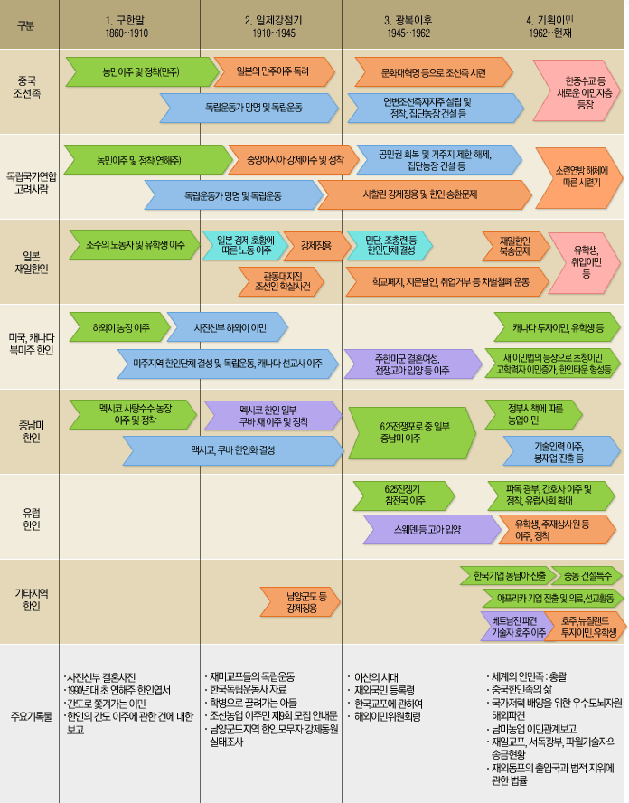
한인 이민의 역사
Notes:
In the middle of the 19th century, people’s situation in Korea got worse and this made people consider immigration. Immigration to China had already occurred, and some people started to immigrate to Hawaii, USA. This was the first wave of Korean immigration to the USA. It is represented as the blue arrows on the bottom line of this timeline. As explained before, Korean immigration began with the difficulties of Korean people. After the liberation of Korea from Japan, through the Korean War, many Korean wives of American soldiers and Korean war orphans adopted by American families immigrated to the USA. This is represented by a purple arrow. This is the second wave of Korean immigration. The annual number of Korean immigrants started increasing in 1965 until now. This is the third wave of Korean immigration. These Korean immigrants are white-collar workers and students who voluntarily moved to America. It is represented by the green arrows on the right side.

Slide 7
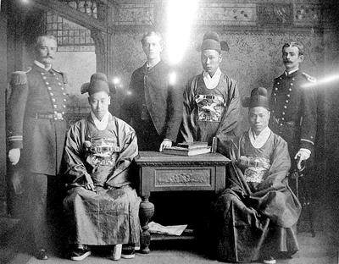
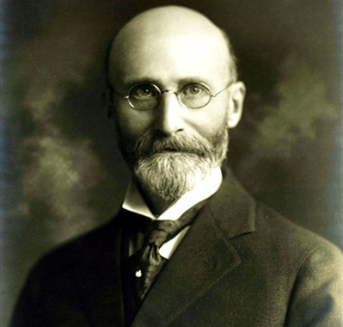
하와이 한인 이민 역사의 시작
1883년 9월 한국 최초의 미국 외교 사절단 (보빙사)
호레이스 알렌: 고종에게 하와이 이주 허락을 구함
한인 최초의 이민(1885~1888년)
유학생, 외교관, 상인 정치인 등
약 50명이 샌프란시스코로 이주
보빙사
호레이스 알렌
Notes:
In September 1883, the first Korean diplomats, 보빙사, was dispatched to the United States.
Horace Allen, a presbyterian missionary and US diplomat, asked 고종 for permission and started recruiting Korean laborers to the US.
From 1885 to 1888, about 50 Korean students, diplomats, merchants, and politicians moved to San Francisco, and it was the first Korean immigration to the United States.

Slide 8
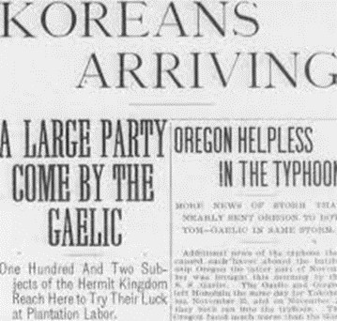
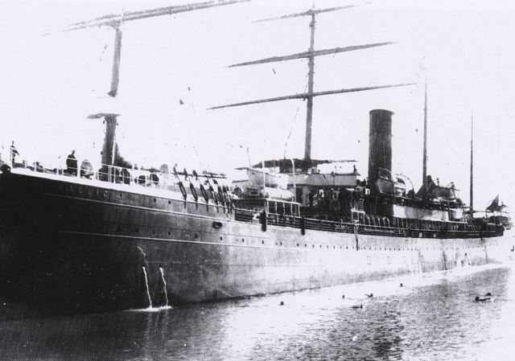
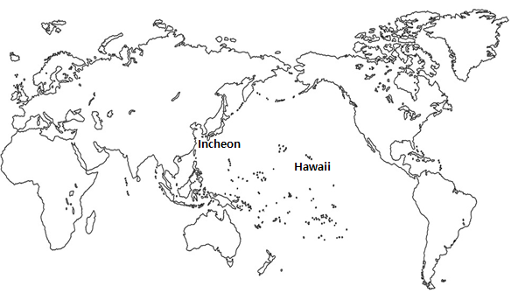
한인 미주 집단 이민역사
1 차 집단 이주 - 1902/12/22, 102명 출발
1903/1/13, 하와이주 오아후섬 도착
1903년 하와이에 도착한 첫 한인 이민에 대한 현지 신문기사
갤릭호(S. S. Gaelic)
Notes:
The first Wave of Korean immigration to the US started December 22, 1902. 102 people departed aboard the S.S Gaelic and arrived in Oahu, Hawaii on January 3, 1903.
This picture is a Hawaiian newspaper article about the journey and the first Korean immigrants in 1903.

Slide 9
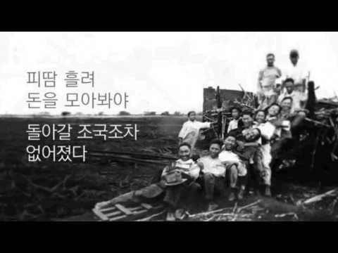
하와이 이민(동영상)
Notes:
Hawaiian sugar cane fields needed workers to harvest the sugarcane. There were already Japanese workers at that time, but they were dissatisfied with the poor working conditions and demanded a wage raise from the white farmers. Threatened by this, white farmers accepted Koreans as cheap labor to replace the Japanese.
Let’s watch a video about the early Korean immigration to Hawaii.

Slide 10
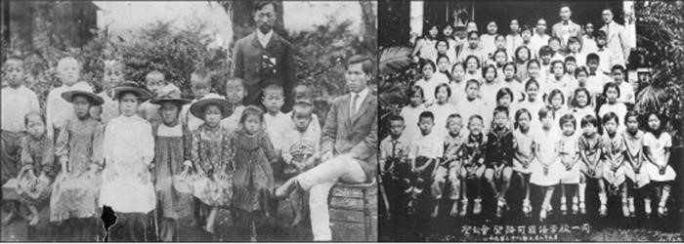
초기 하와이 한글학교 사진
Notes:
These are pictures of Korean language schools set up by Koreans who moved to Hawaii.

Slide 11
이후의 집단 이민
제 2차 집단이주- 1950년대 한국전쟁 이후, 미국병사와 결혼한 한국여성과 전쟁고아들
제 3차 집단이주- 1965 년 이민 규제법 삭제 후, 매해 약 15000 명의 이민
Notes:
After the first wave of Korean immigration to Hawaii, Korean wives of American soldiers and Korean war orphans adopted by American families, all immigrated to the United States. This is called the second wave of Korean immigration. As the immigration control law was removed, after 1965, Korean immigration has become more active. This is the third wave of Korean immigration.

Slide 12
정리
3가지 부류의 미주 초기 이민
  하와이 사탕수수밭 노동 이민부류
  하와이에서 본토로 이민한 부류
  정치적 목적의 망명자 부류
초기 이주 목적 : 경제적 이유와 정치적 동기
Notes:
The early Korean immigrants included migrants that worked in Hawaiian sugar cane fields, migrants from Hawaii to the mainland, and migrants who fled for political purposes. Immigration was mainly caused by economic and political problems.

